Slide 1
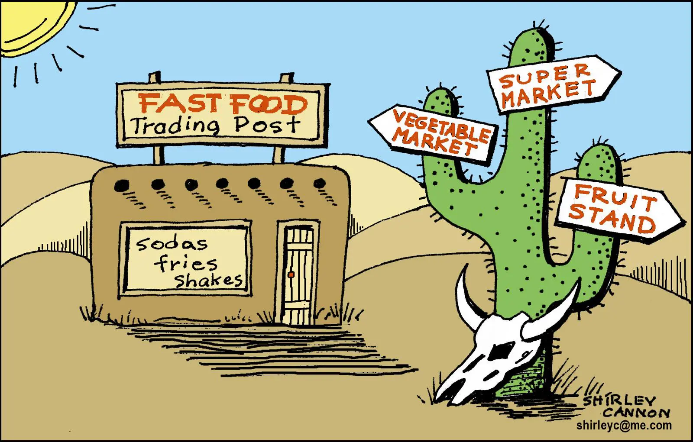

Analysis of Food Deserts in USA
Sudhanshu dotel
Richik Ghosh
Anand Raj

Slide 2
Contents
Workflow
Data Preprocessing & Modeling
Feature Engineering
Exploratory Data Analysis (EDA)
Statistical Tests, Casual Modeling & Insights
Machine Learning Modelling
Key Findings and Policy Recommendations

Slide 3


Workflow
Data modeling
Feature Engineering
EDA & ML Modelling
Statistical Tests
Policy Recommendation
Causal Inferencing

Slide 4



Data modeling
FoodAccessResearchAtlasData2019
Final File
Based on State & County
Food Environment Atlas
Based on State & County

Slide 5
DATA PRE-PROCESSING
Handling NA Values :
For columns that weren't relevant and had majority NA values were dropped.
After dropping irrelevant columns, the rows with NA values were dropped.
Outlier Detection :
To detect outliers' methods like Local Outlier Factor and IQR.
Data Joining :
The "FoodAccessResearchAtlasData2019" data and "FoodEnvironmentAtlas" data were joined to perform Causal Modelling.

Slide 6
Feature engineering
Demographic Percentages: Calculated the percentage of White, Black, Asian, Hispanic, and senior residents by dividing the respective counts by the total 2010 population and multiplying by 100.
Binary Treatment Indicators: For each program (SNAP, CACFP, WIC, Summer Foodservice, Breakfast, Fitness, Farmer's Market), computed the median participation rate and created a binary indicator that flags observations above the median as "high" participation.

Slide 7
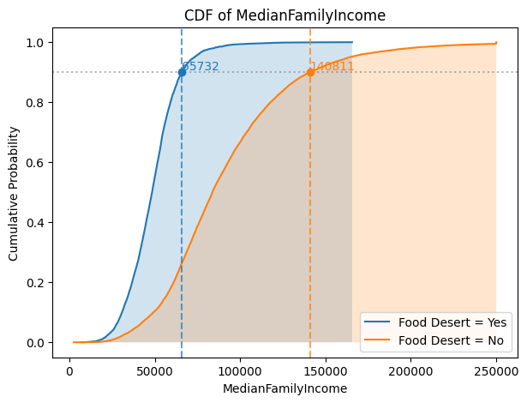
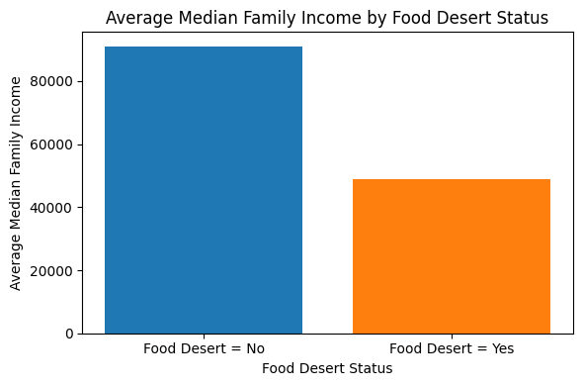
EDA

Slide 8
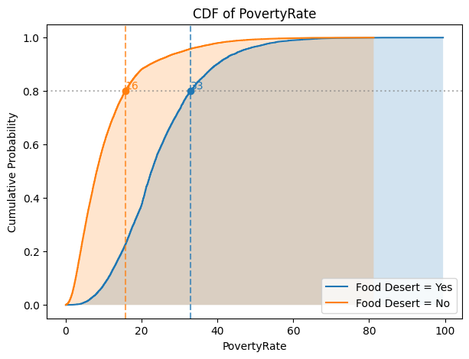
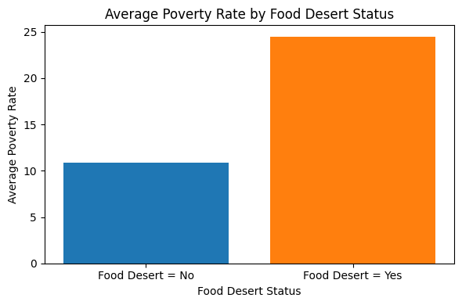
EDA

Slide 9
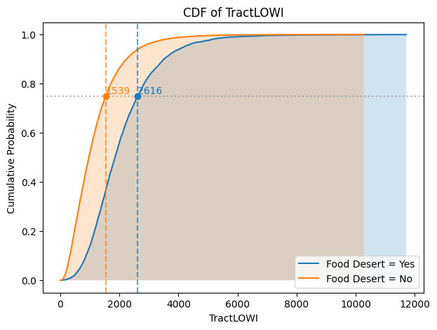
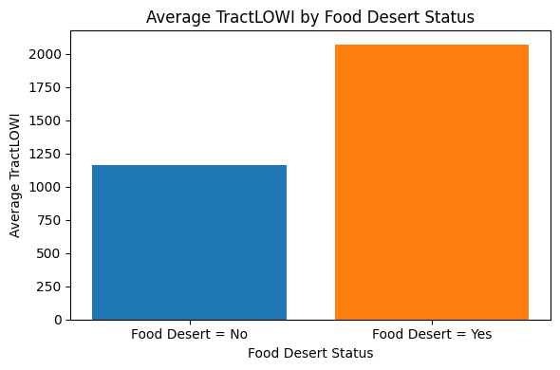
EDA

Slide 10
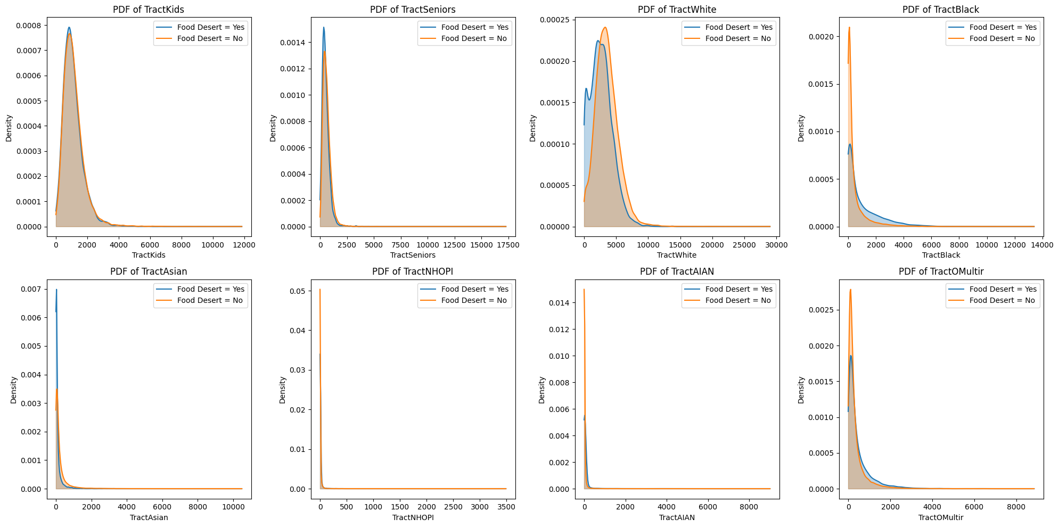
EDA

Slide 11
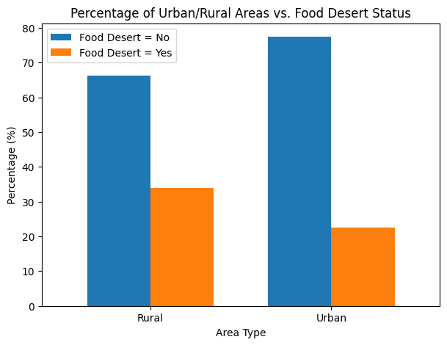
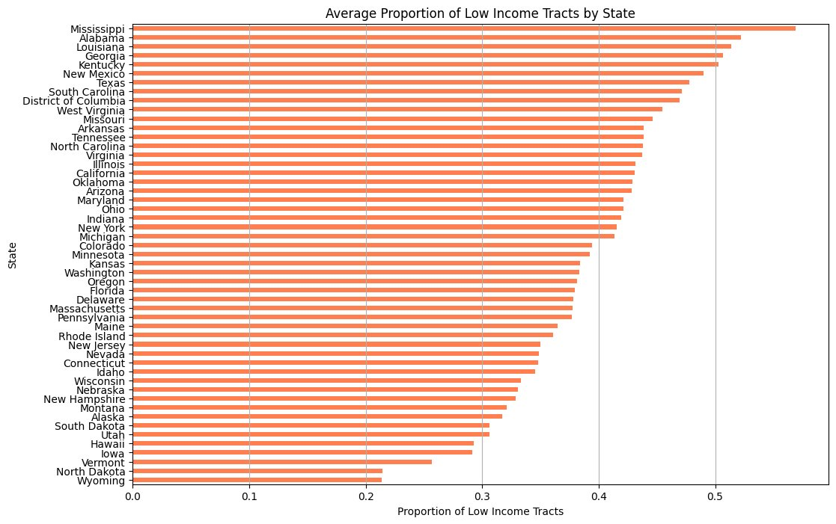
EDA

Slide 12
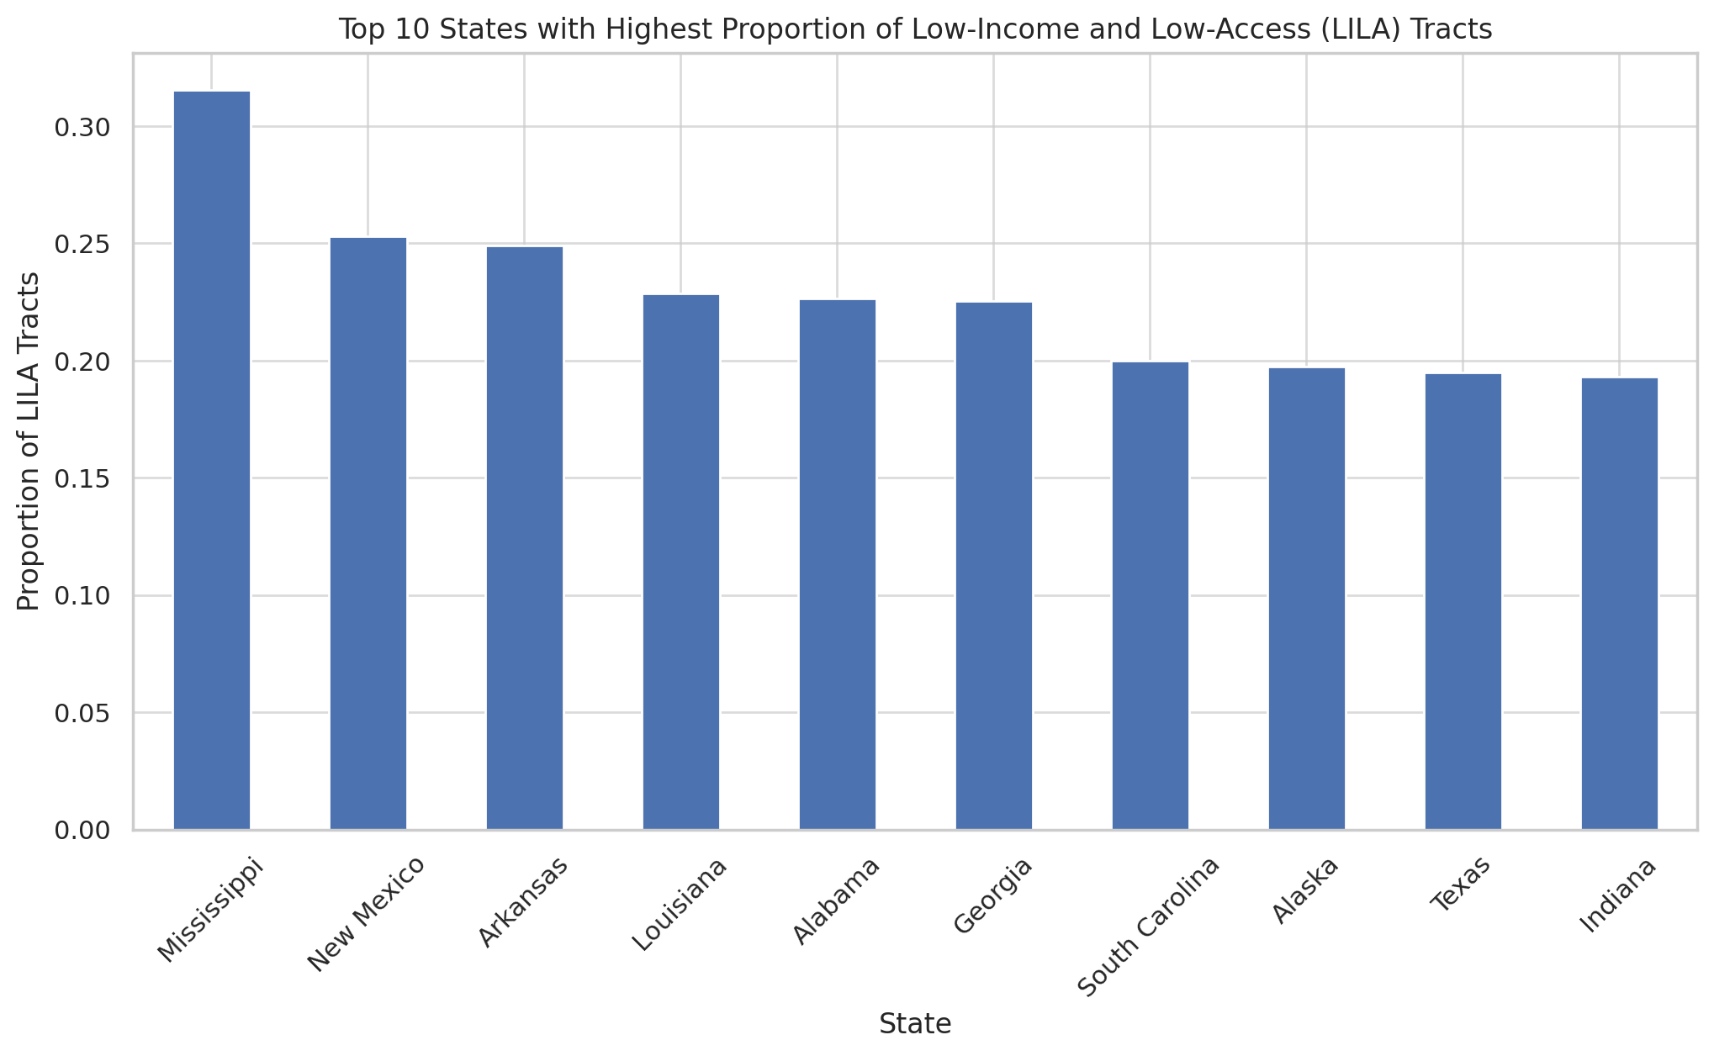
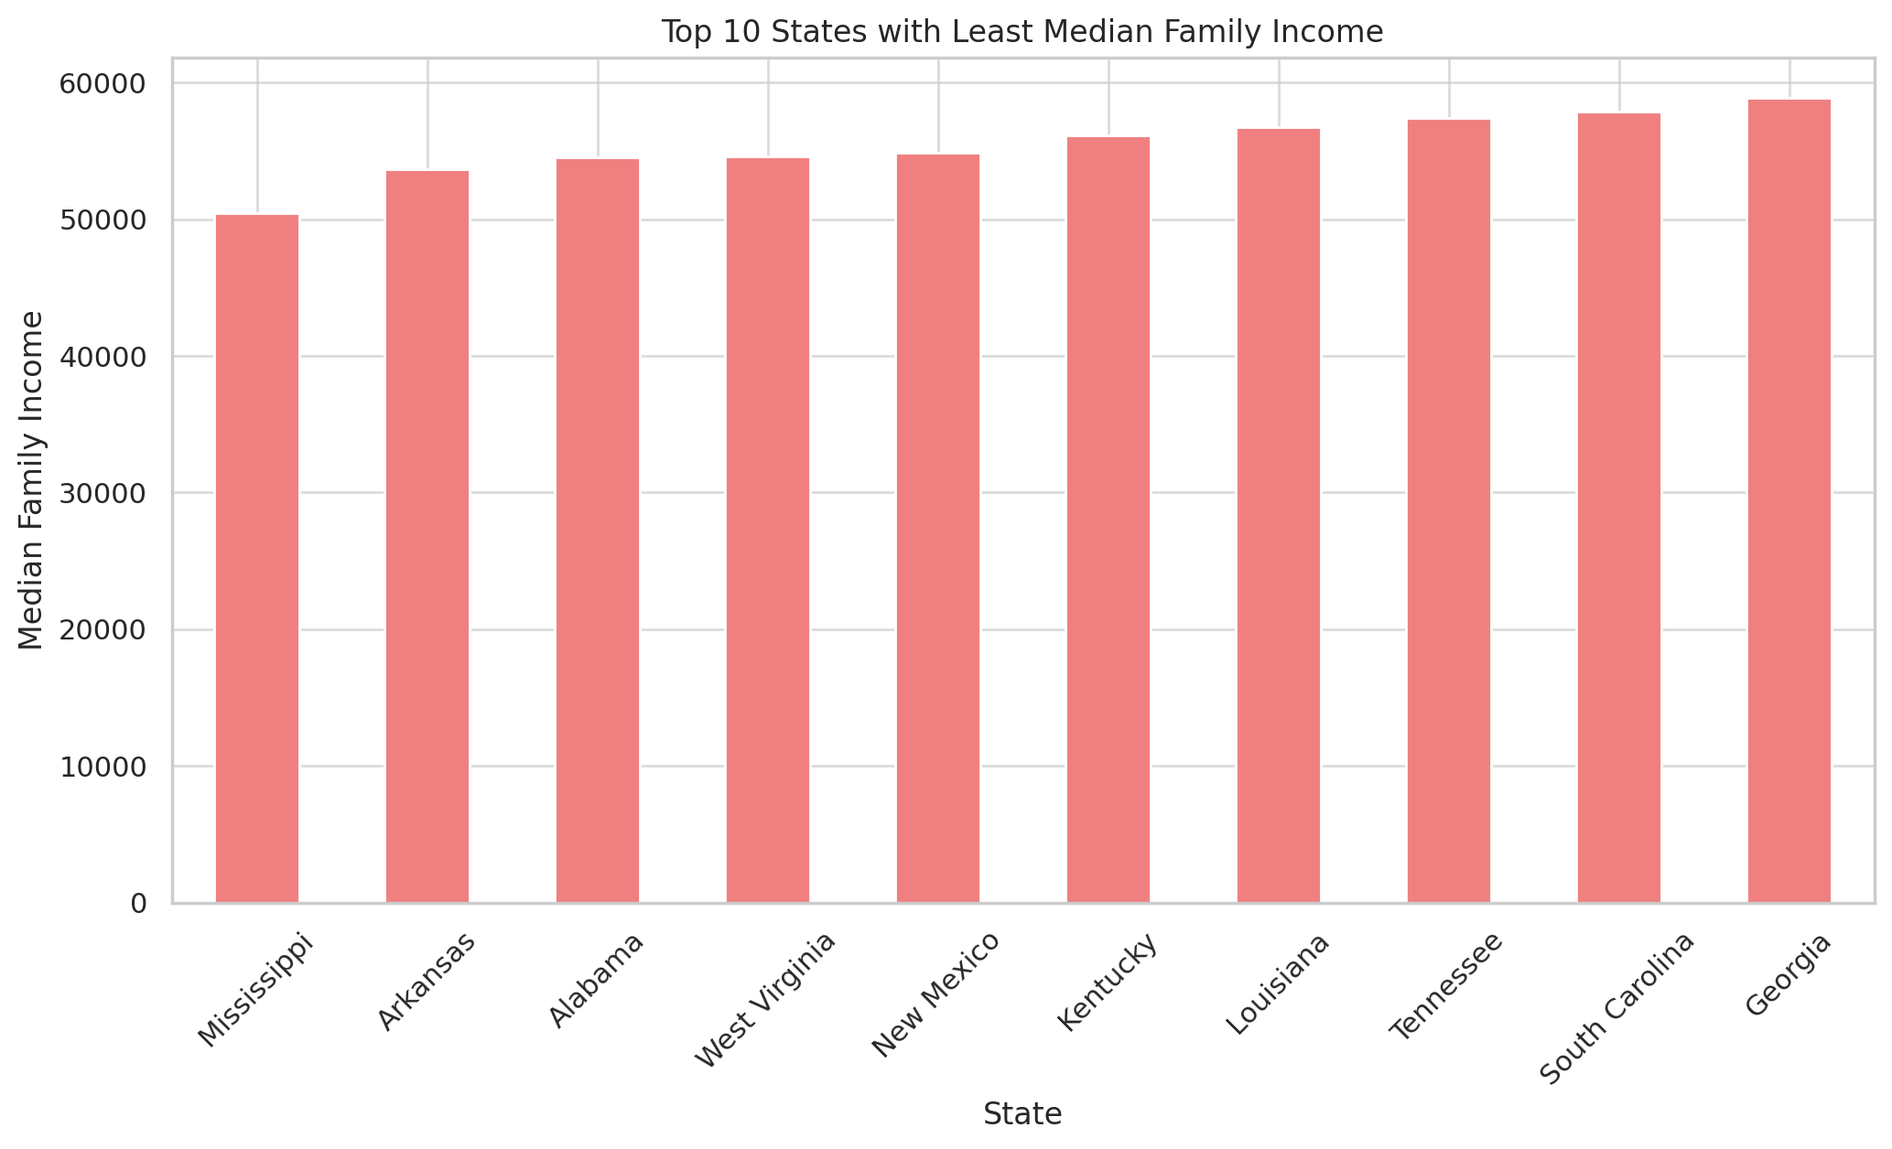
EDA

Slide 13
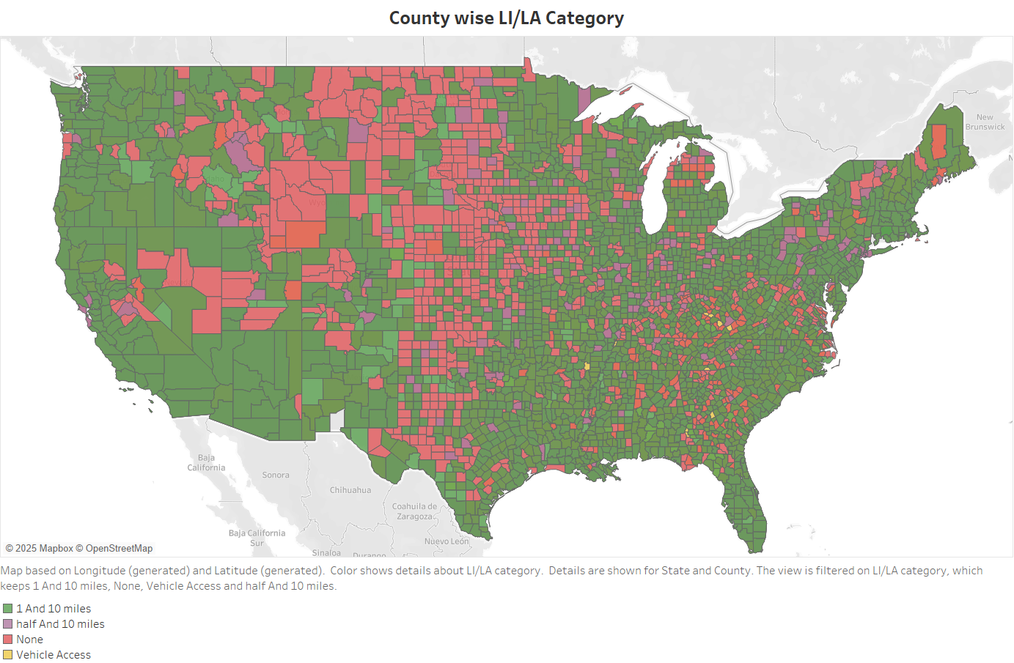
Visualization of food deserts

Slide 14
MACHINE LEARNING MODELLING
Machine Learning Modelling was done to predict food desert in various county for all the states.
Random Forest, Logistic Regression and XG Boost were used to predict food desert.
Model Performance (F1 Score)
Machine Learning Model | Model Performance (F1 Score)
Logistic Regression | 0.73
Random Forest Classifier | 0.80
XGBoost Classifier | 0.79

Slide 15

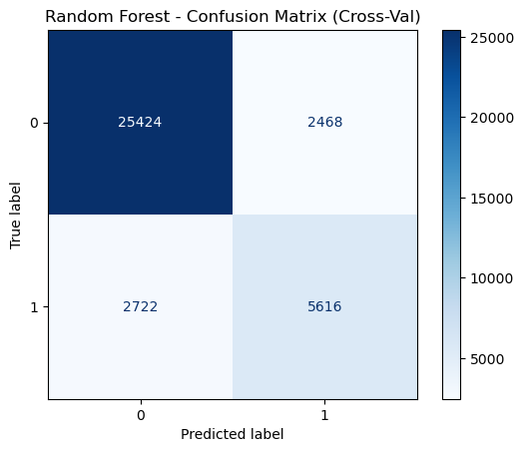
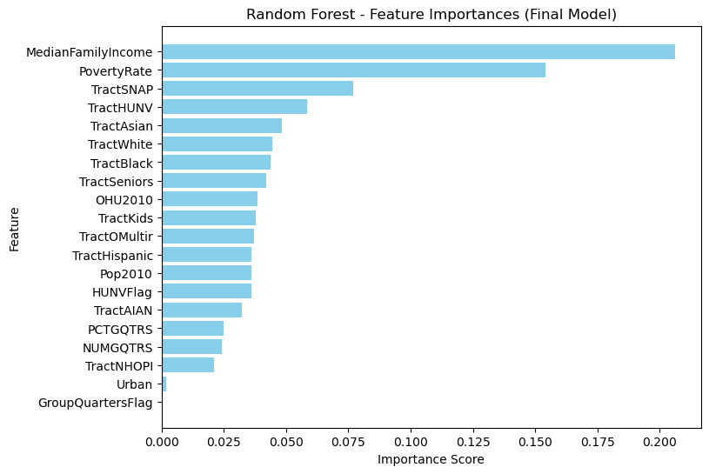
MACHINE LEARNING MODELLING
Confusion Matrix for the best model (Random Forest) and Feature Importance

Slide 16

Statistical Modeling & Causal inferencing

Slide 17
Causal Inferencing based on Food Service for food deserts
Confounders
School Breakfast Program Higher breakfast participation causally reduces the likelihood of residing in a food desert by approximately 3.3 percentage points (PSM ATE = +1.9 pp, p=0.538; IPTW shows a reduction of −3.60 pp, p=0.018; Doubly Robust ATE = −3.31 pp). Recommendation: Promote initiatives that boost breakfast participation to help mitigate food desert conditions, while further investigating the discrepancies between matching and weighting estimates.
High Food Service program participation
Food Desert Indicator
Confounders:
Food Access & Availability Indicators Food Store & Restaurant Density (per 1,000 population)
Nutrition Assistance Program Participation
Local Food & Agricultural Resources
Demographic Indicators
Socioeconomic & Geographic Indicators

Slide 18
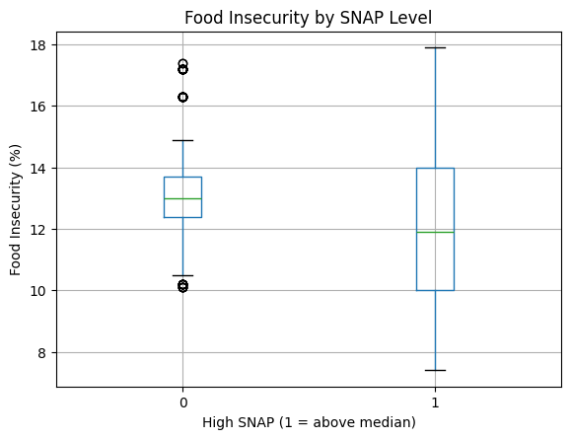
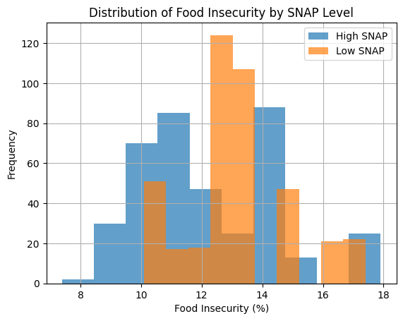
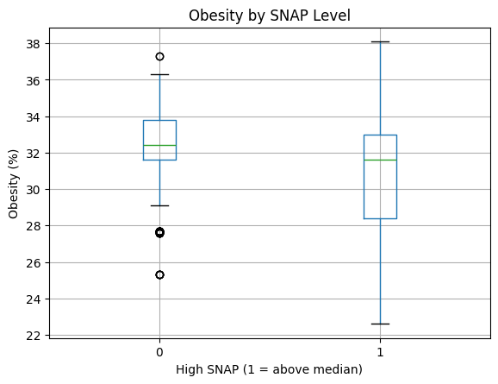
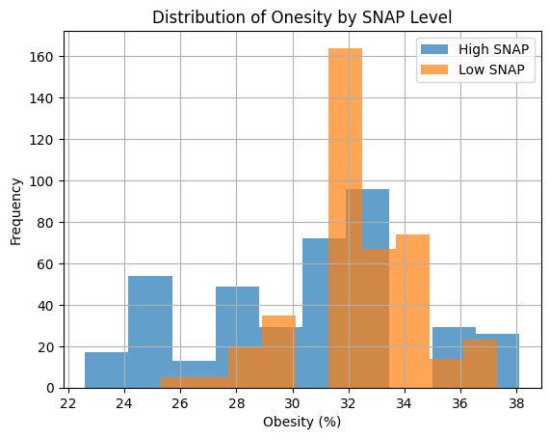
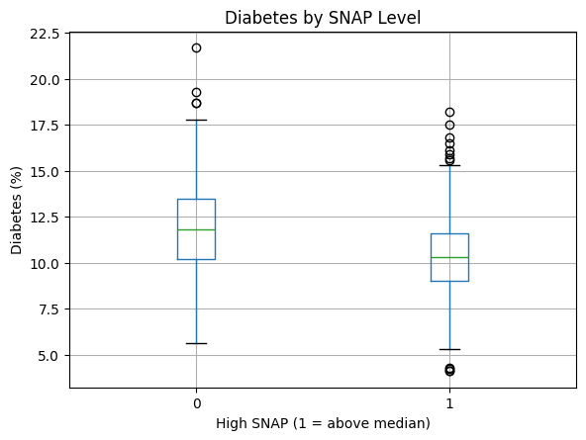
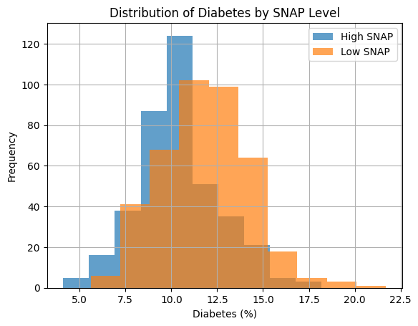
Statistical analysis based on SNAP
Counties with above‑median SNAP participation show significantly lower rates of food insecurity (–0.98 pp), adult obesity (–1.54 pp), and adult diabetes (–1.46 pp) compared to below‑median SNAP counties.
All group differences are statistically significant (t‑tests p < 0.001; Mann–Whitney p < 0.001) with unequal variances confirmed by Levene’s tests.
Effect sizes are moderate, with Cohen’s d = –0.48 (food insecurity), –0.49 (obesity), and –0.63 (diabetes).
Findings suggest higher SNAP participation is associated with better county‑level health outcomes.

Slide 19
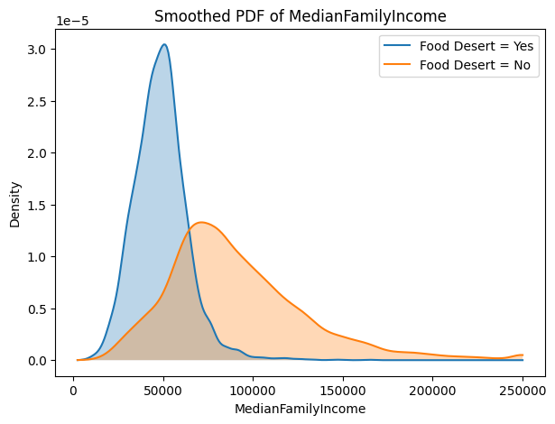
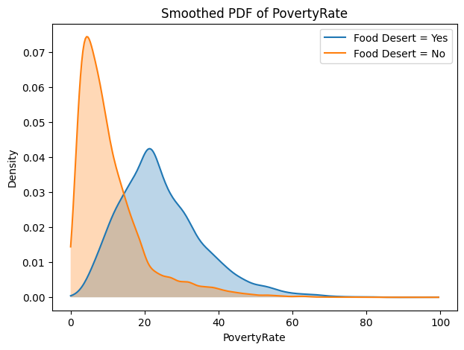
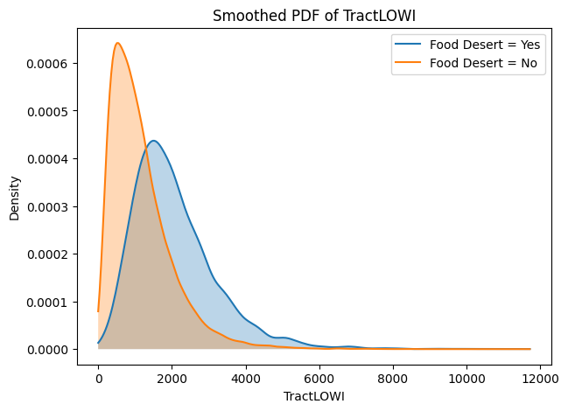
Significant Economic Disparities Between LILA and Non‑LILA Tracts
Tracts designated as LILA (Low Income, Low Access) show: – Higher counts of low‑income residents (TractLOWI). – Substantially lower median family income (–$42,000 on average). – Markedly higher poverty rates (+13.6 pp).
All group differences are statistically significant (t‑tests p < 0.001; Mann–Whitney p < 0.001) with unequal variances confirmed by Levene’s tests.
Effect sizes are large for median family income (d = –1.21) and poverty rate (d = 1.36), underscoring major economic gaps between LILA and non‑LILA tracts.
Findings highlight that LILA status is strongly tied to economic hardship, particularly evident in low‑income population and poverty levels.

Slide 20
Causal Inferencing based on SNAP
Confounders
Higher SNAP participation causally reduces food insecurity by about 1.06 percentage points (PSM ATE; p < 0.001).
Higher SNAP participation causally reduces adult diabetes prevalence by approximately 0.53 percentage points (PSM ATE; p = 0.017) — with IPTW showing a larger, highly significant reduction (–3.80 pp; p < 0.001).
There is no statistically significant causal effect of SNAP participation on adult obesity across any estimation method.
Findings are most robust for food insecurity and diabetes (consistent across PSM and IPTW); obesity effects remain null and should be interpreted cautiously.
High Snap
Obesity, Diabetes,
Food Insecurity
Confounders:
Food Access & Availability Indicators Food Store & Restaurant Density (per 1,000 population)
Nutrition Assistance Program Participation
Local Food & Agricultural Resources
Demographic Indicators
Socioeconomic & Geographic Indicators
Food Desert Indicator

Slide 21
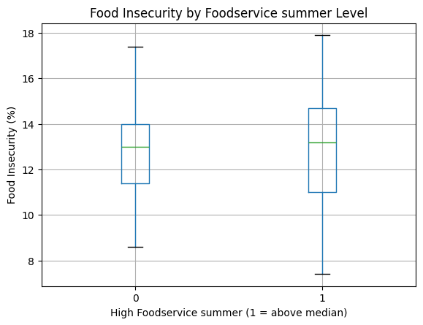
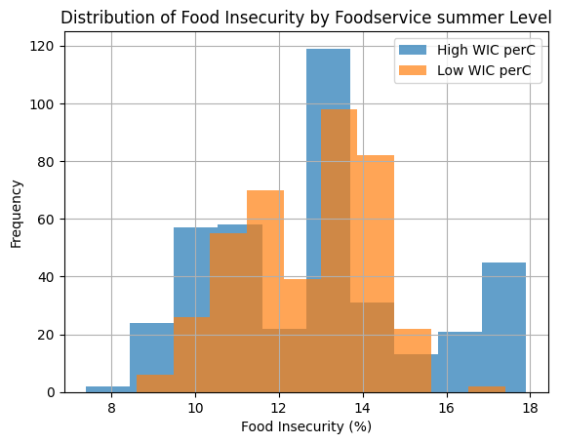
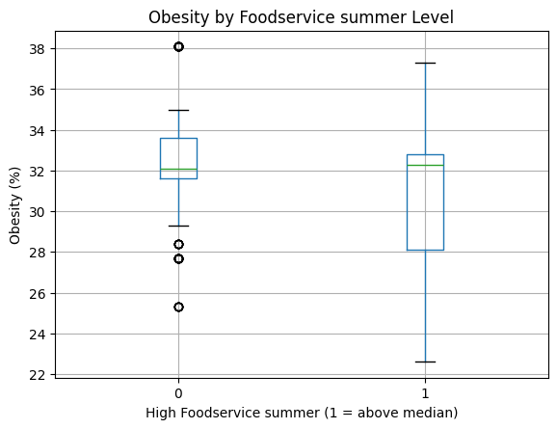
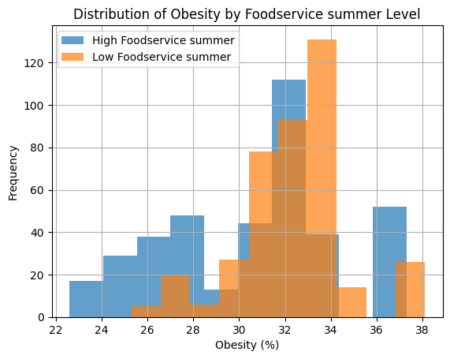
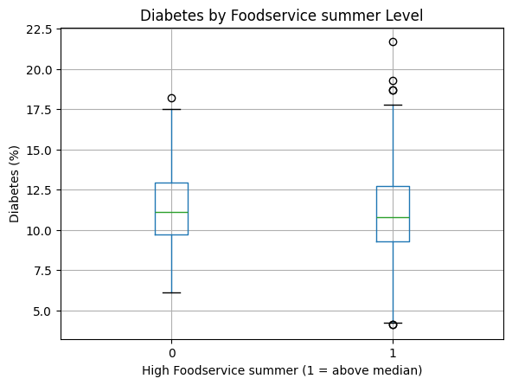
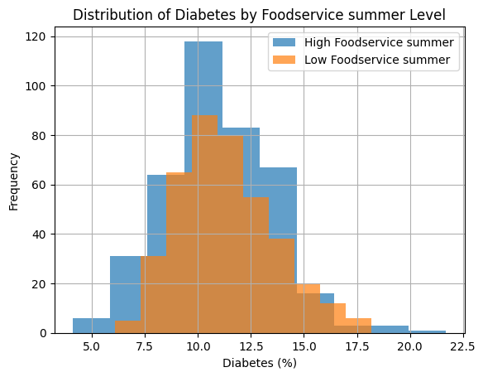
Statistical analysis based on Summer Food Service
Counties with above‑median summer foodservice participation show slightly higher food insecurity (+0.35 pp), but lower adult obesity (−1.70 pp) and lower adult diabetes (−0.39 pp) compared to below‑median counties.
All group differences were significant by independent‑samples t‑tests (food insecurity: t=2.37, p=0.018; obesity: t=–7.51, p<0.001; diabetes: t=–2.24, p=0.025) with unequal variances confirmed by Levene’s tests; Mann–Whitney U tests were significant for obesity (p<0.001), borderline for diabetes (p=0.051), and non‑significant for food insecurity (p=0.495).
Effect sizes were small for food insecurity (Cohen’s d=0.17) and diabetes (d=–0.16), and medium for obesity (d=–0.54).
These findings suggest higher summer foodservice participation is associated with modest improvements in county‑level obesity and diabetes rates, despite a slight increase in measured food insecurity.

Slide 22
Causal Inferencing based on Summer Food Service
Confounders
Higher summer foodservice participation causally increases food insecurity by ~0.72 percentage points (PSM ATE; p=0.005) — IPTW confirms a similar increase (+0.92 pp; p<0.001).
Higher summer foodservice participation causally reduces adult obesity prevalence by ~0.73 percentage points (PSM ATE; p=0.013) — IPTW shows a comparable reduction (−0.60 pp; p=0.009).
No statistically significant causal effect on adult diabetes (PSM ATE p=0.412; IPTW p=0.649), indicating null findings across estimation methods.
Recommendation: Expand summer foodservice programming to capitalize on its protective effect against obesity, but pair with targeted anti‑food‑insecurity interventions to mitigate its unintended increase in measured food insecurity.
High Summer Food service
Obesity, Diabetes,
Food Insecurity
Confounders:
Food Access & Availability Indicators Food Store & Restaurant Density (per 1,000 population)
Nutrition Assistance Program Participation
Local Food & Agricultural Resources
Demographic Indicators
Socioeconomic & Geographic Indicators
Food Desert Indicator

Slide 23
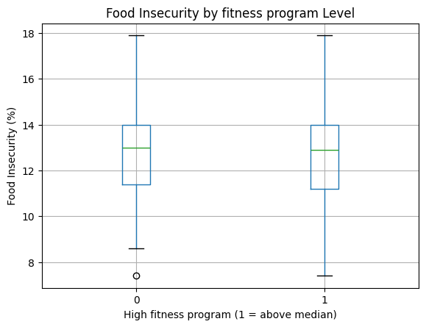
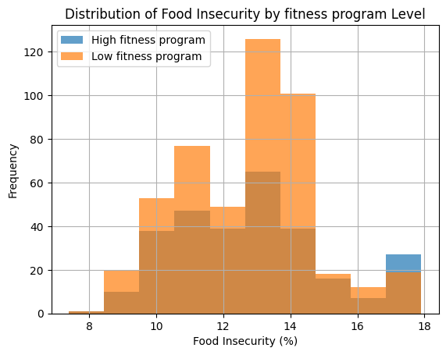
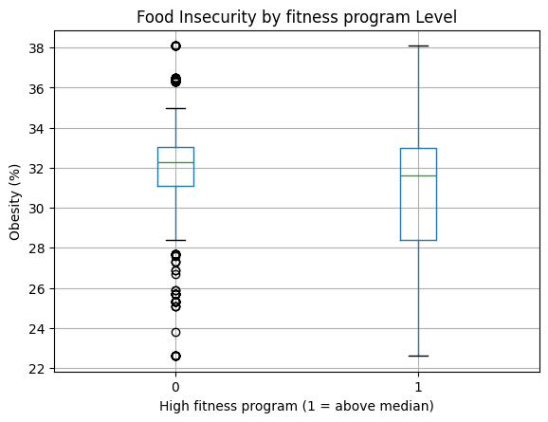
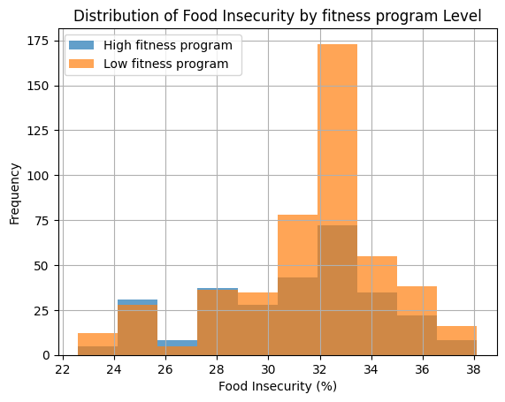
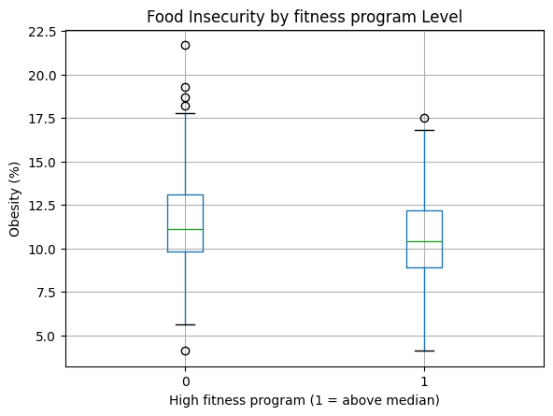
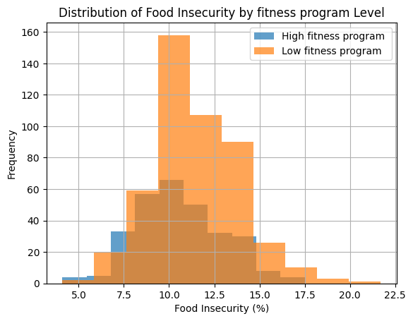
Statistical analysis based on Fitness center
Counties with above‑median recreation/facility participation show virtually no change in food insecurity (+0.07 pp), but lower adult obesity (−0.78 pp) and lower adult diabetes (−0.78 pp) compared to below‑median counties.
All group differences were non‑significant for food insecurity (t=0.451, p=0.652; Levene’s p=0.0074 → unequal variances; Mann–Whitney p=0.676), significant for obesity (t=–3.152, p=0.0017; Levene’s p=0.0054 → unequal variances; Mann–Whitney p=0.0005), and significant for diabetes (t=–4.361, p<0.001; Levene’s p=0.528 → equal variances; Mann–Whitney p<0.001).
Effect sizes were negligible for food insecurity (Cohen’s d=0.035), small for obesity (d=–0.239) and diabetes (d=–0.325).
Recommendation: Scale up county recreation/facility programming to help reduce obesity and diabetes at the population level, while continuing to monitor food insecurity (no adverse effect detected).

Slide 24
Causal Inferencing based on Fitness center
Confounders
Higher recreation/facility participation shows a non‑significant increase in food insecurity (+0.21 pp; PSM ATE p=0.136) — IPTW yields a borderline increase (+0.30 pp; p=0.053).
No statistically significant causal effect on adult obesity (PSM ATE p=0.867; IPTW p=0.674).
No statistically significant causal effect on adult diabetes (PSM ATE p=0.236; IPTW p=0.311).
Recommendation: Given null causal impacts on food insecurity, obesity, and diabetes, resources should be prioritized toward interventions with demonstrated health benefits (e.g., summer foodservice). Continue monitoring recreation/facility programming for potential subgroup effects but de‑prioritize it as a standalone strategy for reducing county‑level food insecurity or chronic disease prevalence.
High Fitness centers
Obesity, Diabetes,
Food Insecurity
Confounders:
Food Access & Availability Indicators Food Store & Restaurant Density (per 1,000 population)
Nutrition Assistance Program Participation
Local Food & Agricultural Resources
Demographic Indicators
Socioeconomic & Geographic Indicators
Food Desert Indicator

Slide 25
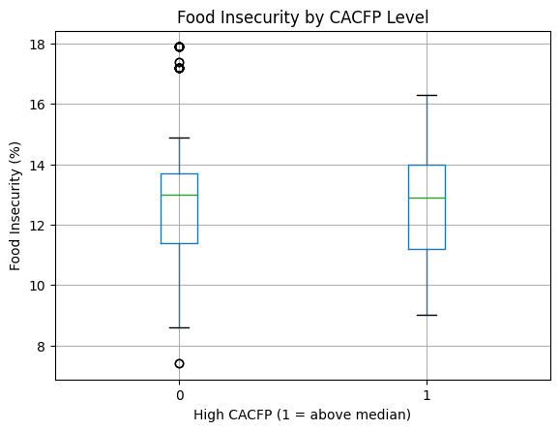
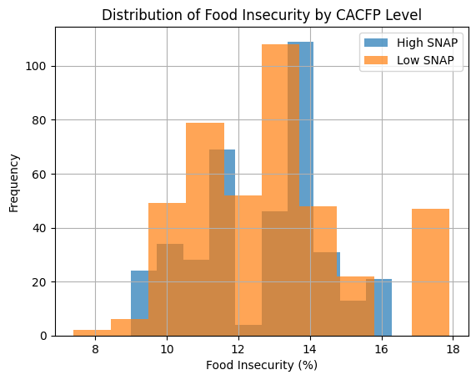
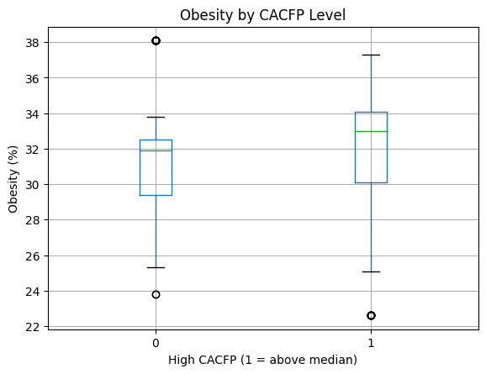
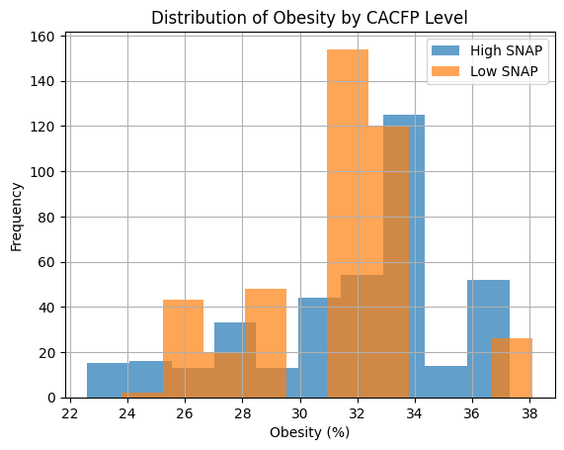
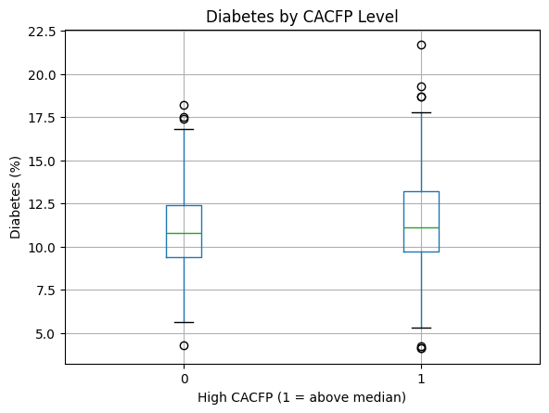
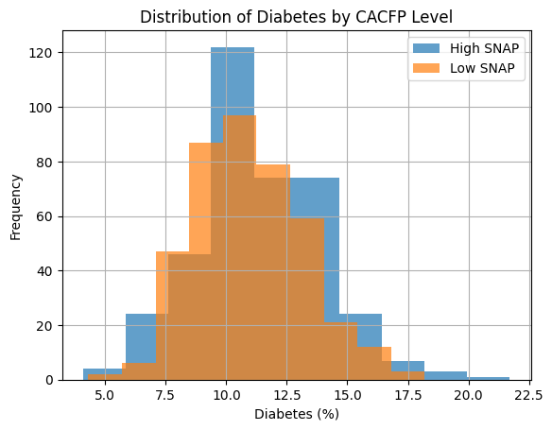
Statistical analysis based on Child and ADULT care
Counties with above‑median CACFP participation show a slight decrease in food insecurity (−0.18 pp), but increases in adult obesity (+0.55 pp) and adult diabetes (+0.38 pp) compared to below‑median counties.
All group differences were non‑significant for food insecurity (t=−1.223, p=0.222; Levene’s p=0.362 → equal variances; Mann–Whitney p=0.762), significant for obesity (t=2.333, p=0.0199; Levene’s p=0.0017 → unequal variances; Mann–Whitney p<0.001), and significant for diabetes (t=2.156, p=0.0314; Levene’s p=0.0114 → unequal variances; Mann–Whitney p=0.0199).
Effect sizes were negligible for food insecurity (Cohen’s d=–0.087) and small for obesity (d=0.167) and diabetes (d=0.154).
Recommendation: Reevaluate CACFP implementation—while it does not worsen food insecurity, its association with small increases in obesity and diabetes suggests the need for program enhancements (e.g., nutrition quality improvements) rather than expansion as a standalone health intervention.

Slide 26
Causal Inferencing based on Child and ADULT care
Confounders
Higher CACFP participation causally reduces food insecurity by ~0.40 pp (PSM ATE p=0.183; IPTW shows a larger reduction of −2.26 pp, p<0.001).
Higher CACFP participation causally increases adult obesity prevalence by ~0.95 pp (PSM ATE p=0.001; IPTW shows an increase of +2.11 pp, p<0.001).
Higher CACFP participation causally increases adult diabetes prevalence by ~0.09 pp (PSM ATE p=0.633; IPTW shows an increase of +0.45 pp, p=0.002).
Recommendation: Continue CACFP expansion to address food insecurity, but urgently revise program nutritional standards (e.g., healthier meal guidelines, obesity‑prevention education) to offset its unintended association with higher obesity and diabetes rates.
High C&A care
Obesity, Diabetes,
Food Insecurity
Confounders:
Food Access & Availability Indicators Food Store & Restaurant Density (per 1,000 population)
Nutrition Assistance Program Participation
Local Food & Agricultural Resources
Demographic Indicators
Socioeconomic & Geographic Indicators
Food Desert Indicator

Slide 27

POLICY Recommendations
Increase Employment: The employment in areas with Food Desert must be increased to decrease poverty rate and increase median family income.
Support SNAP Programs: Expand SNAP to reduce food insecurity and diabetes, while seeking additional strategies to address obesity.
Leverage Summer Foodservice: Increase participation to lower obesity rates, but implement measures to mitigate its unintended rise in food insecurity.
Refocus Recreation/Facility Efforts: Redirect resources from recreation/facility programs, which lack significant health impacts, to more effective interventions.
Revise CACFP Standards: Continue CACFP expansion for food insecurity benefits, but urgently update nutritional guidelines to counter associated obesity and diabetes increases.
Promote initiatives that increase breakfast participation to reduce food desert conditions, while investigating discrepancies between matching and weighting estimates for more accurate policy insights.

